Slide 1
Welcome to our Year 5 Team
Teachers: Miss Hubble (5A), Miss O’Regan (5R)
and Mrs Hayer(5H)
Support staff: Mrs Drayton-Chana, Mrs Morris, Mrs Stokes
Year Group Leader : Mrs Hayer

Slide 2
Curriculum
Autumn Term – It’s All Greek To Me!
Challenge: How can we celebrate the legacy of Ancient Greece?
Hook Day Greek Workshop Tuesday 27th September
(please pay £5 contribution on ParentPay)
Spring Term – Man vs Food
Challenge: How can we promote fair trade through a healthy tuck shop?
Summer Term – Power Struggles
Challenge: How can we educate others about the anglo-Saxons and Vikings struggle for England??

Slide 3
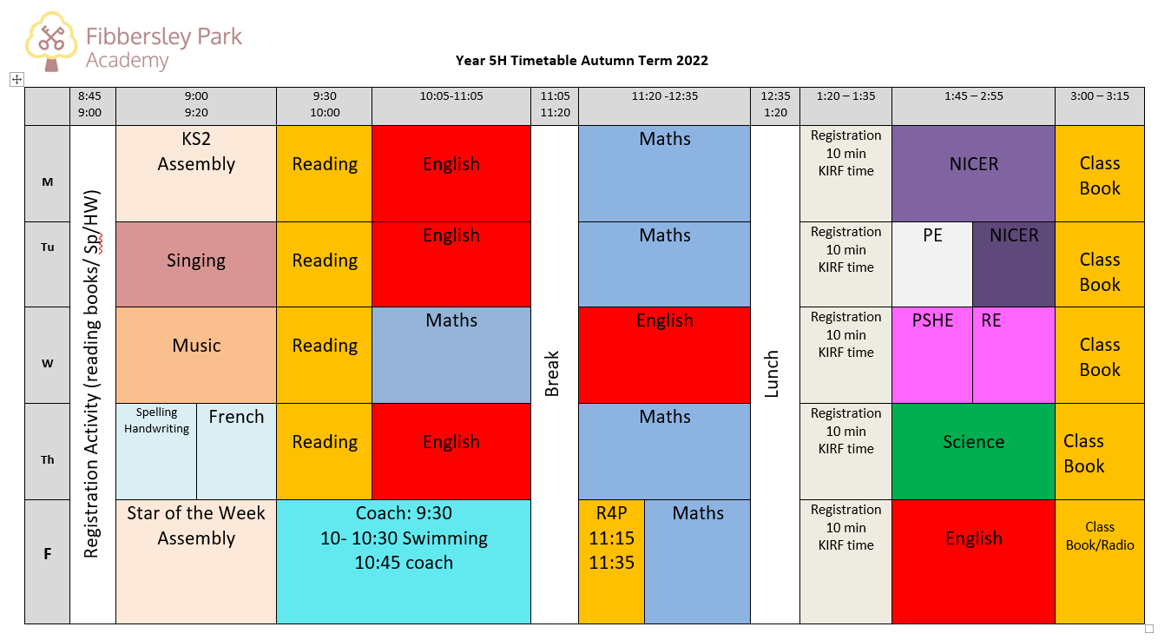
Timetable example

Slide 4
What do I need to know?
Classroom expectations and routines
- Reading books and records, drinks/toilet, school uniforms
Swimming weekly on a Friday (to be confirmed)
PE Kits (Tuesday)
Class reading 3:00pm. The school day ends at 3:15pm.
Homework
Reading (approx. 20-30 mins daily)
My Maths (tasks set weekly on Weds linked to what has been taught that week)
Spellings (10 spellings set, tested on Thursday)
Times tables (ideally ch should know all times tables up to 12 x12)
NICER homework (1 piece of homework to be handed in Aut 1 and Aut 2
( Hand in dates: October 22nd and one by December 9th)

Slide 5
What do I need to know?
Behaviour
Class Chart points
Star of the Week certificate
FIDES certificate

Slide 6
What do I need to know?
Parents/carers are expected to:
Encourage respect and good behaviour
Make their children aware of inappropriate behaviour
Behave appropriately towards children, staff and other parents/carers
Tell staff about anything that may affect learning, well-being or behaviour of their child in school
Support the school in its implementation of the behaviour policy
Supervise and deal with the behaviour of their own children when on school site
Report any concerns to staff about the behaviour of other children and not deal with incidents themselves
Supervise their children’s use of the internet and social media, following e-safety guidelines

Slide 7
Questions?

